Slide 1
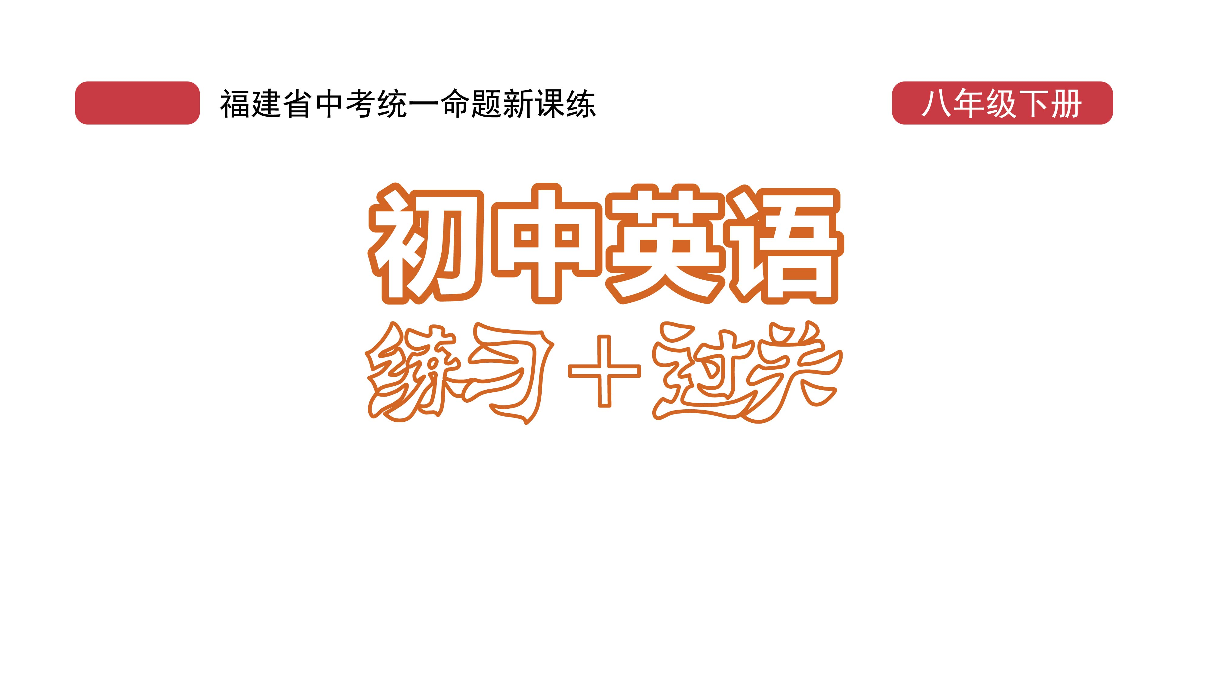
课时练习
模块八 第三章 第二节

Slide 2
一、翻译下列词组。
1. 在……的中心 _____________________
2. 一条传统连衣裙 _____________________
3. 在……领域 ______________________
4. 高级时装 _______________________
5. 少数民族服装 _________________________
6. 对……了解很多 _______________________
in the center of …
a traditional dress
in the world/field of …
high fashion
minority costumes
know a lot about …

Slide 3
二、根据语境、音标或所给单词的提示完成句子， 每空一词。
1. Mashed Taros (or yuni) is a __________(tradition) dessert in Fuzhou.
2. There are 55 ________ (minority) in our country.
3. On the __________ /ˈkætwɔːk/ the models walked around in the latest summer clothing.
traditional
minorities
catwalk

Slide 4
二、根据语境、音标或所给单词的提示完成句子， 每空一词。
4. Many people enjoy the spiciness(辛辣) of _______ /kəˈriːən/ food.
5. The poster_______there will be an art show next month.
Korean
says

Slide 5
三、单项选择。
( )1. —Can you look after my dog for me while I’m away?
—_________.
A. With pleasure B. Not at all
C. Oh, you are right
A

Slide 6
三、单项选择。
( )2. Look! Here___________!
A. the bus come
B. come the bus
C. comes the bus
C

Slide 7
三、单项选择。
( )3. —The bronze horse head（马首铜像） is now on show. Do you know______to Yuanmingyuan?
—On December 1st, 2020.
A. when will it return
B. when did it return
C. when it returned
C

Slide 8
三、单项选择。
( )4. —_______ do you like the costume party?
—It’s wonderful.
A. What B. How C. Where
B

Slide 9
三、单项选择。
( )5. If you aren’t quite sure ____ a decision, you should go and ask somebody else.
A. about B. to C. with
A

Slide 10
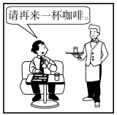
四、看图写话。
1. want, another
The man/He wants/wanted another cup of coffee.

Slide 11
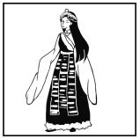
四、看图写话。
2. minority, costume
The girl is in a minority costume./
She wears a minority costume.

Slide 12
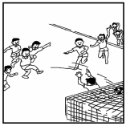
四、看图写话。
3. there be, tomorrow
There will be a soccer match tomorrow./
There is going to be a football game tomorrow.

Slide 13
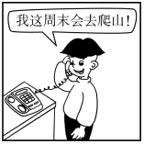
四、看图写话。
4. say
The boy says he will go (mountain) climbing this weekend./
He said he would climb a mountain this weekend.

Slide 14
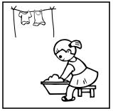
四、看图写话。
5. now
The girl/She is washing (her) clothes now.

Slide 15
